Slide 1
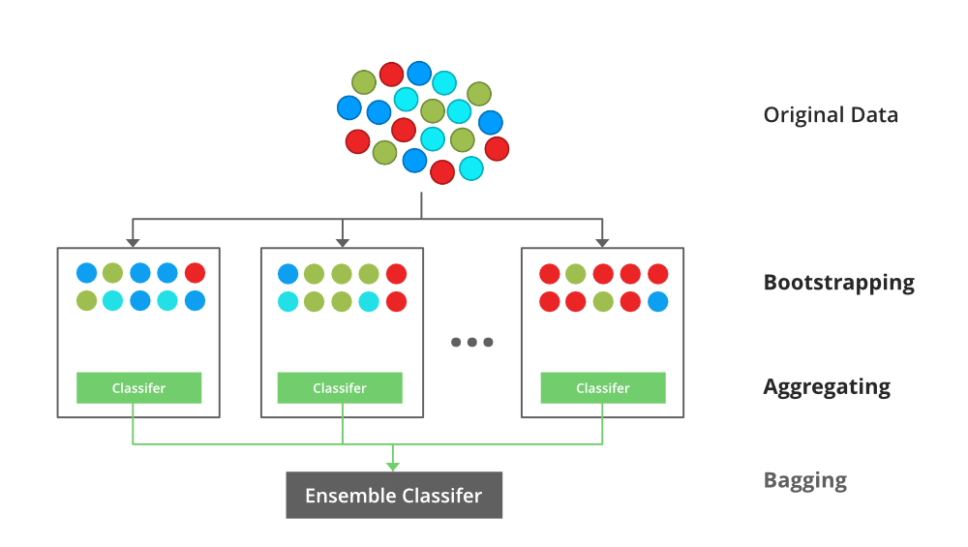
Boosting is an ensemble modelling, technique that attempts to build a strong classifier from the number of weak classifiers. It is done by building a model by using weak models in series. Firstly, a model is built from the training data. Then the second model is built which tries to correct the errors present in the first model. This procedure is continued and models are added until either the complete training data set is predicted correctly or the maximum number of models are added.
XGBoost is an implementation of Gradient Boosted decision trees. XGBoost models majorly dominate in many Kaggle Competitions.
XGBOOST
In this algorithm, decision trees are created in sequential form. Weights play an important role in XGBoost. Weights are assigned to all the independent variables which are then fed into the decision tree which predicts results.
The weight of variables predicted wrong by the tree is increased and these variables are then fed to the second decision tree. These individual classifiers/predictors then ensemble to give a strong and more precise model. It can work on regression, classification, ranking, and user-defined prediction problems.

Slide 2
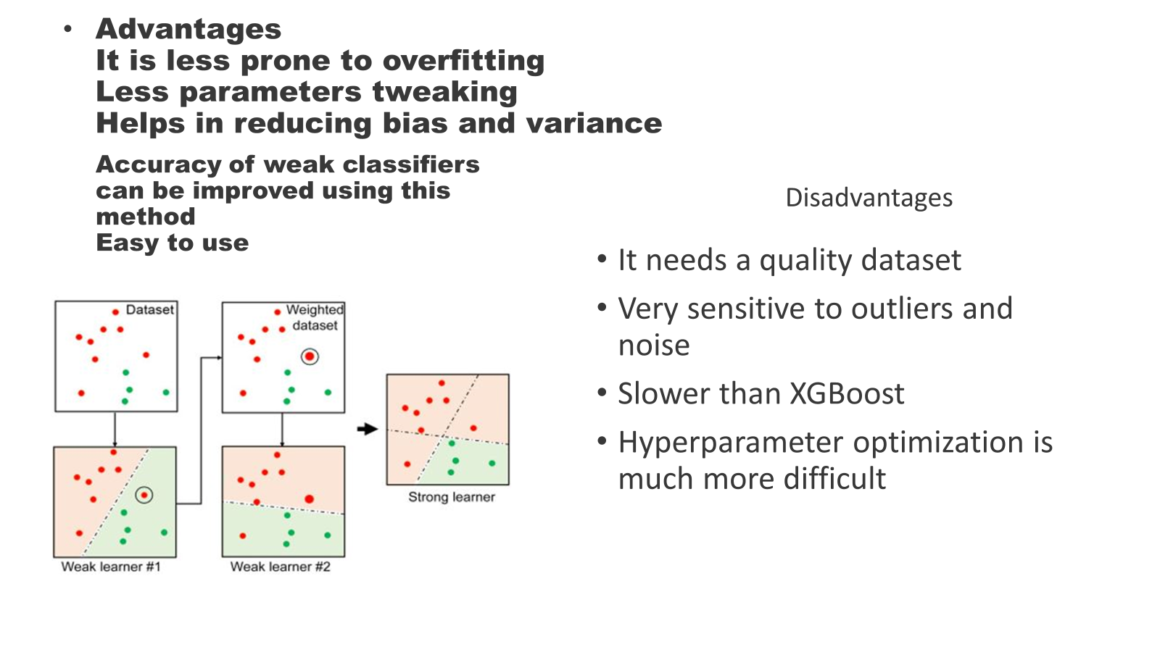

Slide 3
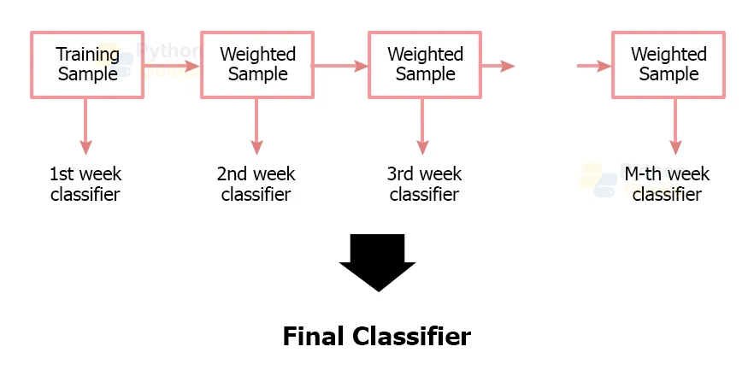
This article will deal with one of the implementations of Gradient Boosting Algorithms- XGBoost Algorithm. Since its inception in 2014, XGBoost has always been a lauded algorithm for implementing Machine Learning models. The algorithm has a wide range of applications ranging from predicting ad click-through rates to the classification of high energy physics events. Known for its speed and accuracy, XGBoost is an implementation of gradient boosted decision trees.
XGBoost initially started as a research project by Tianqi Chen as part of the Distributed (Deep) Machine Learning Community (DMLC) group. Initially, it began as a terminal application that could be configured using a libsvm configuration file. It became well known in the ML competition circles after its use in the winning solution of the Higgs Machine Learning Challenge. Soon after, the Python and R packages were built, and XGBoost now has package implementations for Java, Scala, Julia, Perl, and other languages.
While the XGBoost model often achieves higher accuracy than a single decision tree, it sacrifices the intrinsic interpretability of decision trees. For example, following the path that a decision tree takes to make its decision is trivial and self-explained, but following the paths of hundreds or thousands of trees is much harder.

Slide 4
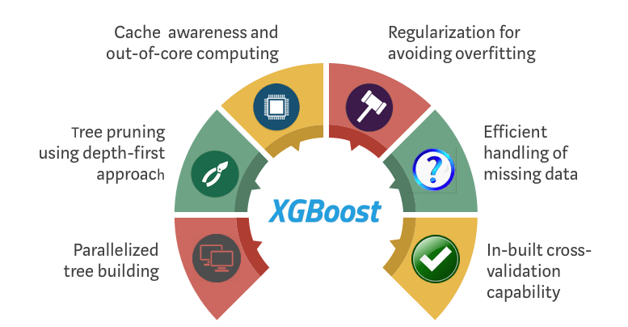
GBoost classifier is a Machine learning algorithm that is applied for structured and tabular data. XGBoost is an implementation of gradient boosted decision trees designed for speed and performance. XGBoost is an extreme gradient boost algorithm. And that means it’s a big Machine learning algorithm with lots of parts. XGBoost works with large, complicated datasets. XGBoost is an ensemble modelling technique.
CLASSIFER ALGORITHM
Both types of algorithms fall under the supervised ML category.

Slide 5
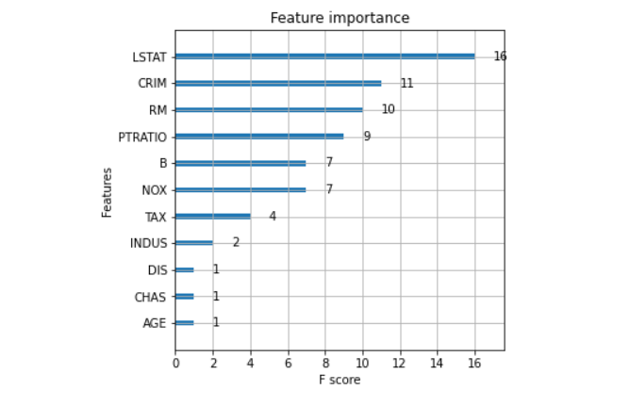
Xgboost is an ensemble machine learning algorithm that uses gradient boosting. Its goal is to optimize both the model performance and the execution speed. It can be used for both regression and classification problems. xgboost (extreme gradient boosting) is an advanced version of the gradient descent boosting technique, which is used for increasing the speed and efficiency of computation of the algorithm.
Step:1 Load necessary libraries
from sklearn.datasets import load_boston from sklearn.metrics import mean_squared_error from sklearn.model_selection import train_test_split import xgboost as xgb import pandas as pd import numpy as np import matplotlib.pyplot as plt
boston = load_boston()
# shape of boston data
print(boston.data.shape)
print(boston.keys())
print(boston.feature_names)
Step:2 Splitting data
X_train, X_test, y_train, y_test = train_test_split(X, y, test_size=0.2, random_state=123)
Step:3 XGBoost regressor
xg_reg = xgb.XGBRegressor(objective ='reg:linear', colsample_bytree = 0.3, learning_rate = 0.1,max_depth = 5, alpha = 10, n_estimators = 10)

